Slide 1
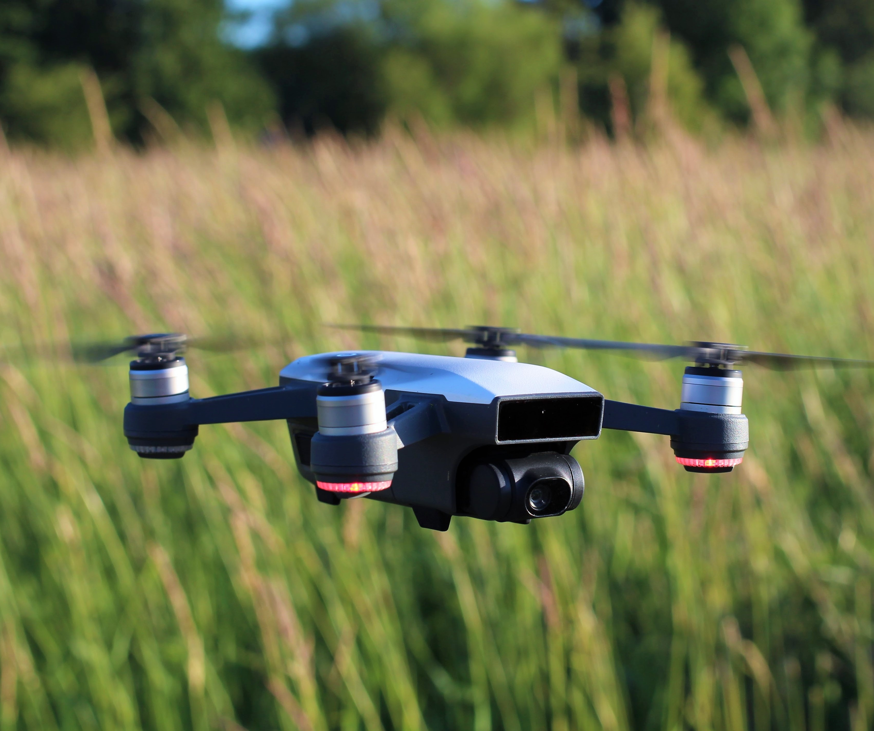
Altitude Detection and Adjustment Proposal
Stryder R. Coleman

Slide 2
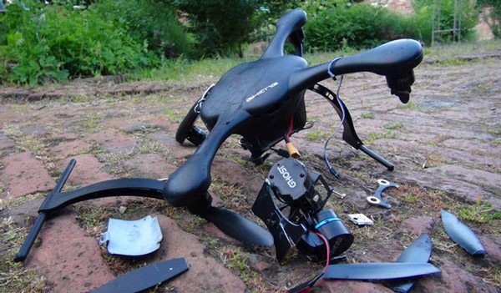
Problem
Possible crashes
The Lowering of an autonomous ground vehicle

Slide 3
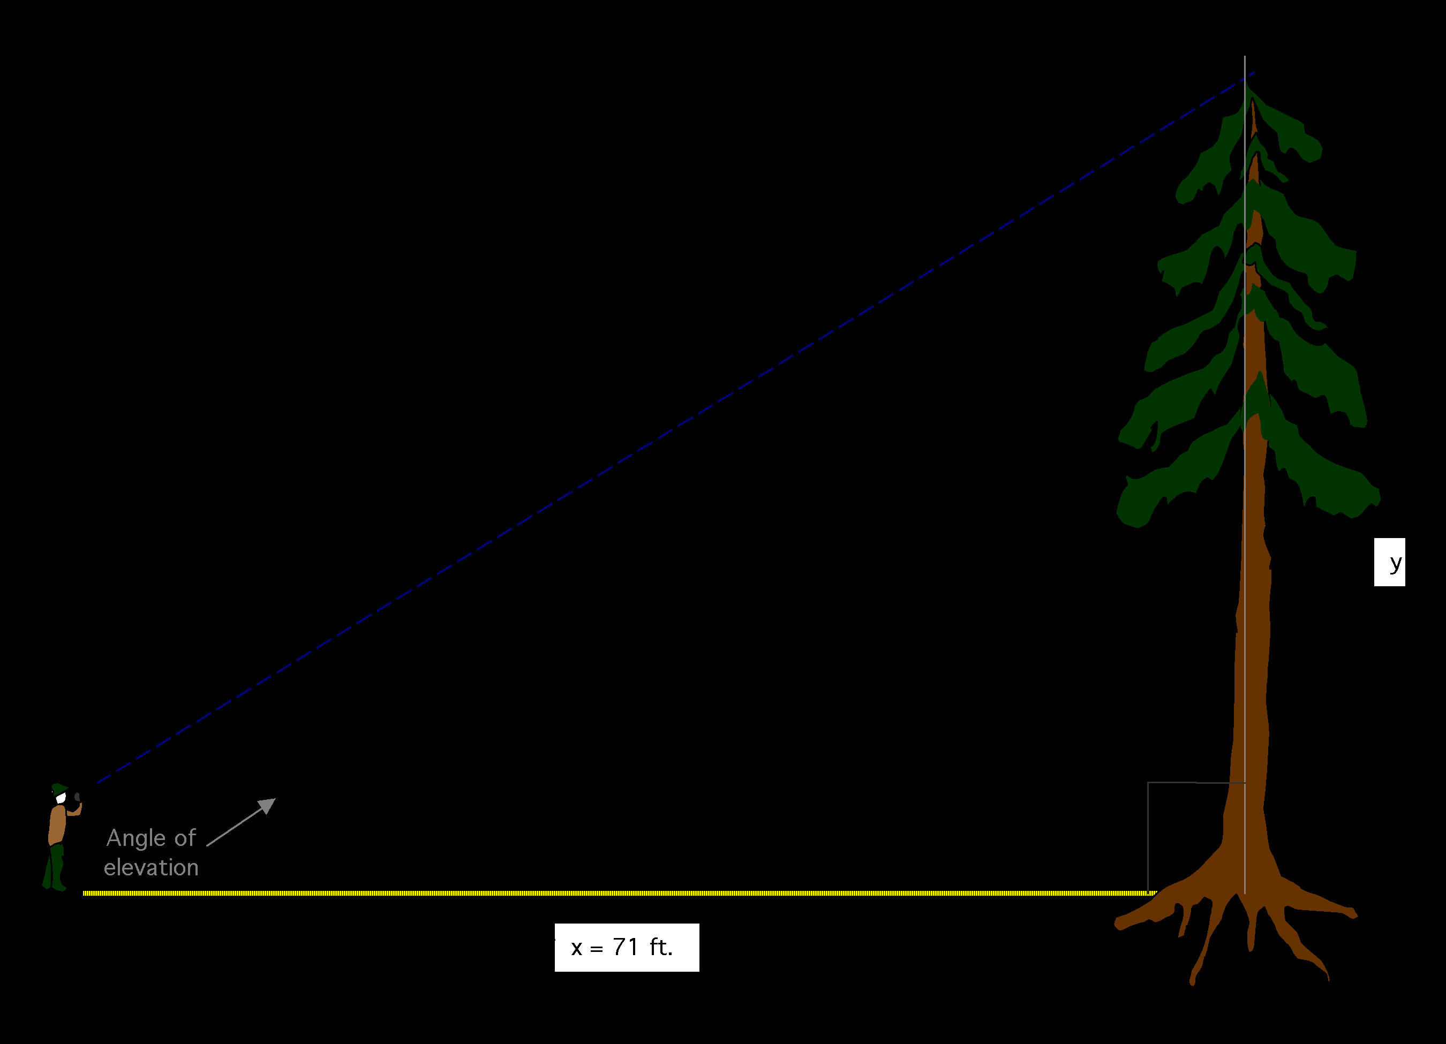
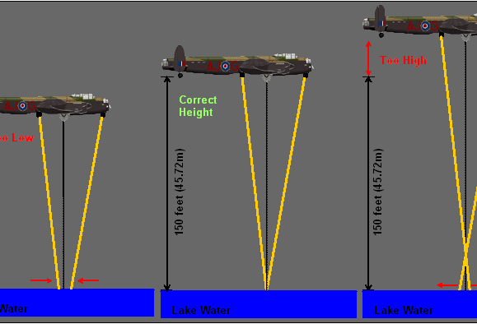
Solution: The Development of an altitude detection and adjustment system

Slide 4
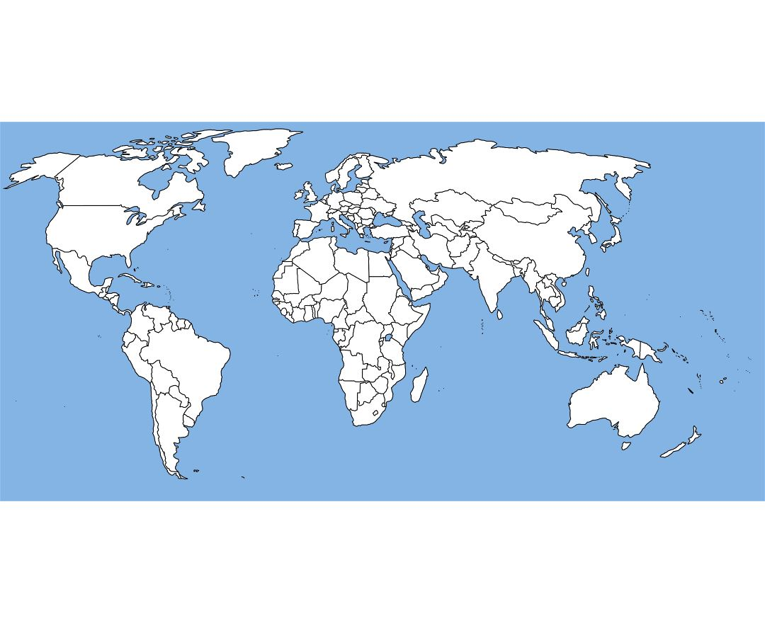
How?
* Open Maps altitude detection
* Calculating the change in altitude
* Processing if the altitude change is to high
* Relaying information between systems
* Adjusting propellers accordingly

Slide 5
Benefits
Crash Protection
More Data for the Judges
More Precision for Lowering the Autonomous Ground Vehicle
A System to Build Upon

Slide 6
Teams Involved
Mechanical
Programming

Slide 7
Schedule
December 22nd
New drone should be completed
Open Maps altitude feature will be implemented
Front-end to base-station communication will be setup
December 29th
Altitude change method will be made and tested in JMavSim
January 5th
Implement system to old drone
Test old Drone
January 12th
Implement system to new drone
January 19th
Test new drone and rework code

Slide 8

The Budget

Slide 9
Concerns
How is this free?
How much time will this take?
Who should the tasks be delegated to?
What software will be used?

Slide 10
Summary
Utilizing Open Maps altitude feature
Setting up the future
Learning from last year

